Slide 1

Unravelling ChatGPT: Training & Architecture Assignment 7: A Deep Dive into architecture and training of ChatGPT
Devesh Surve
20th March 2024
ID: 002766974

Slide 2
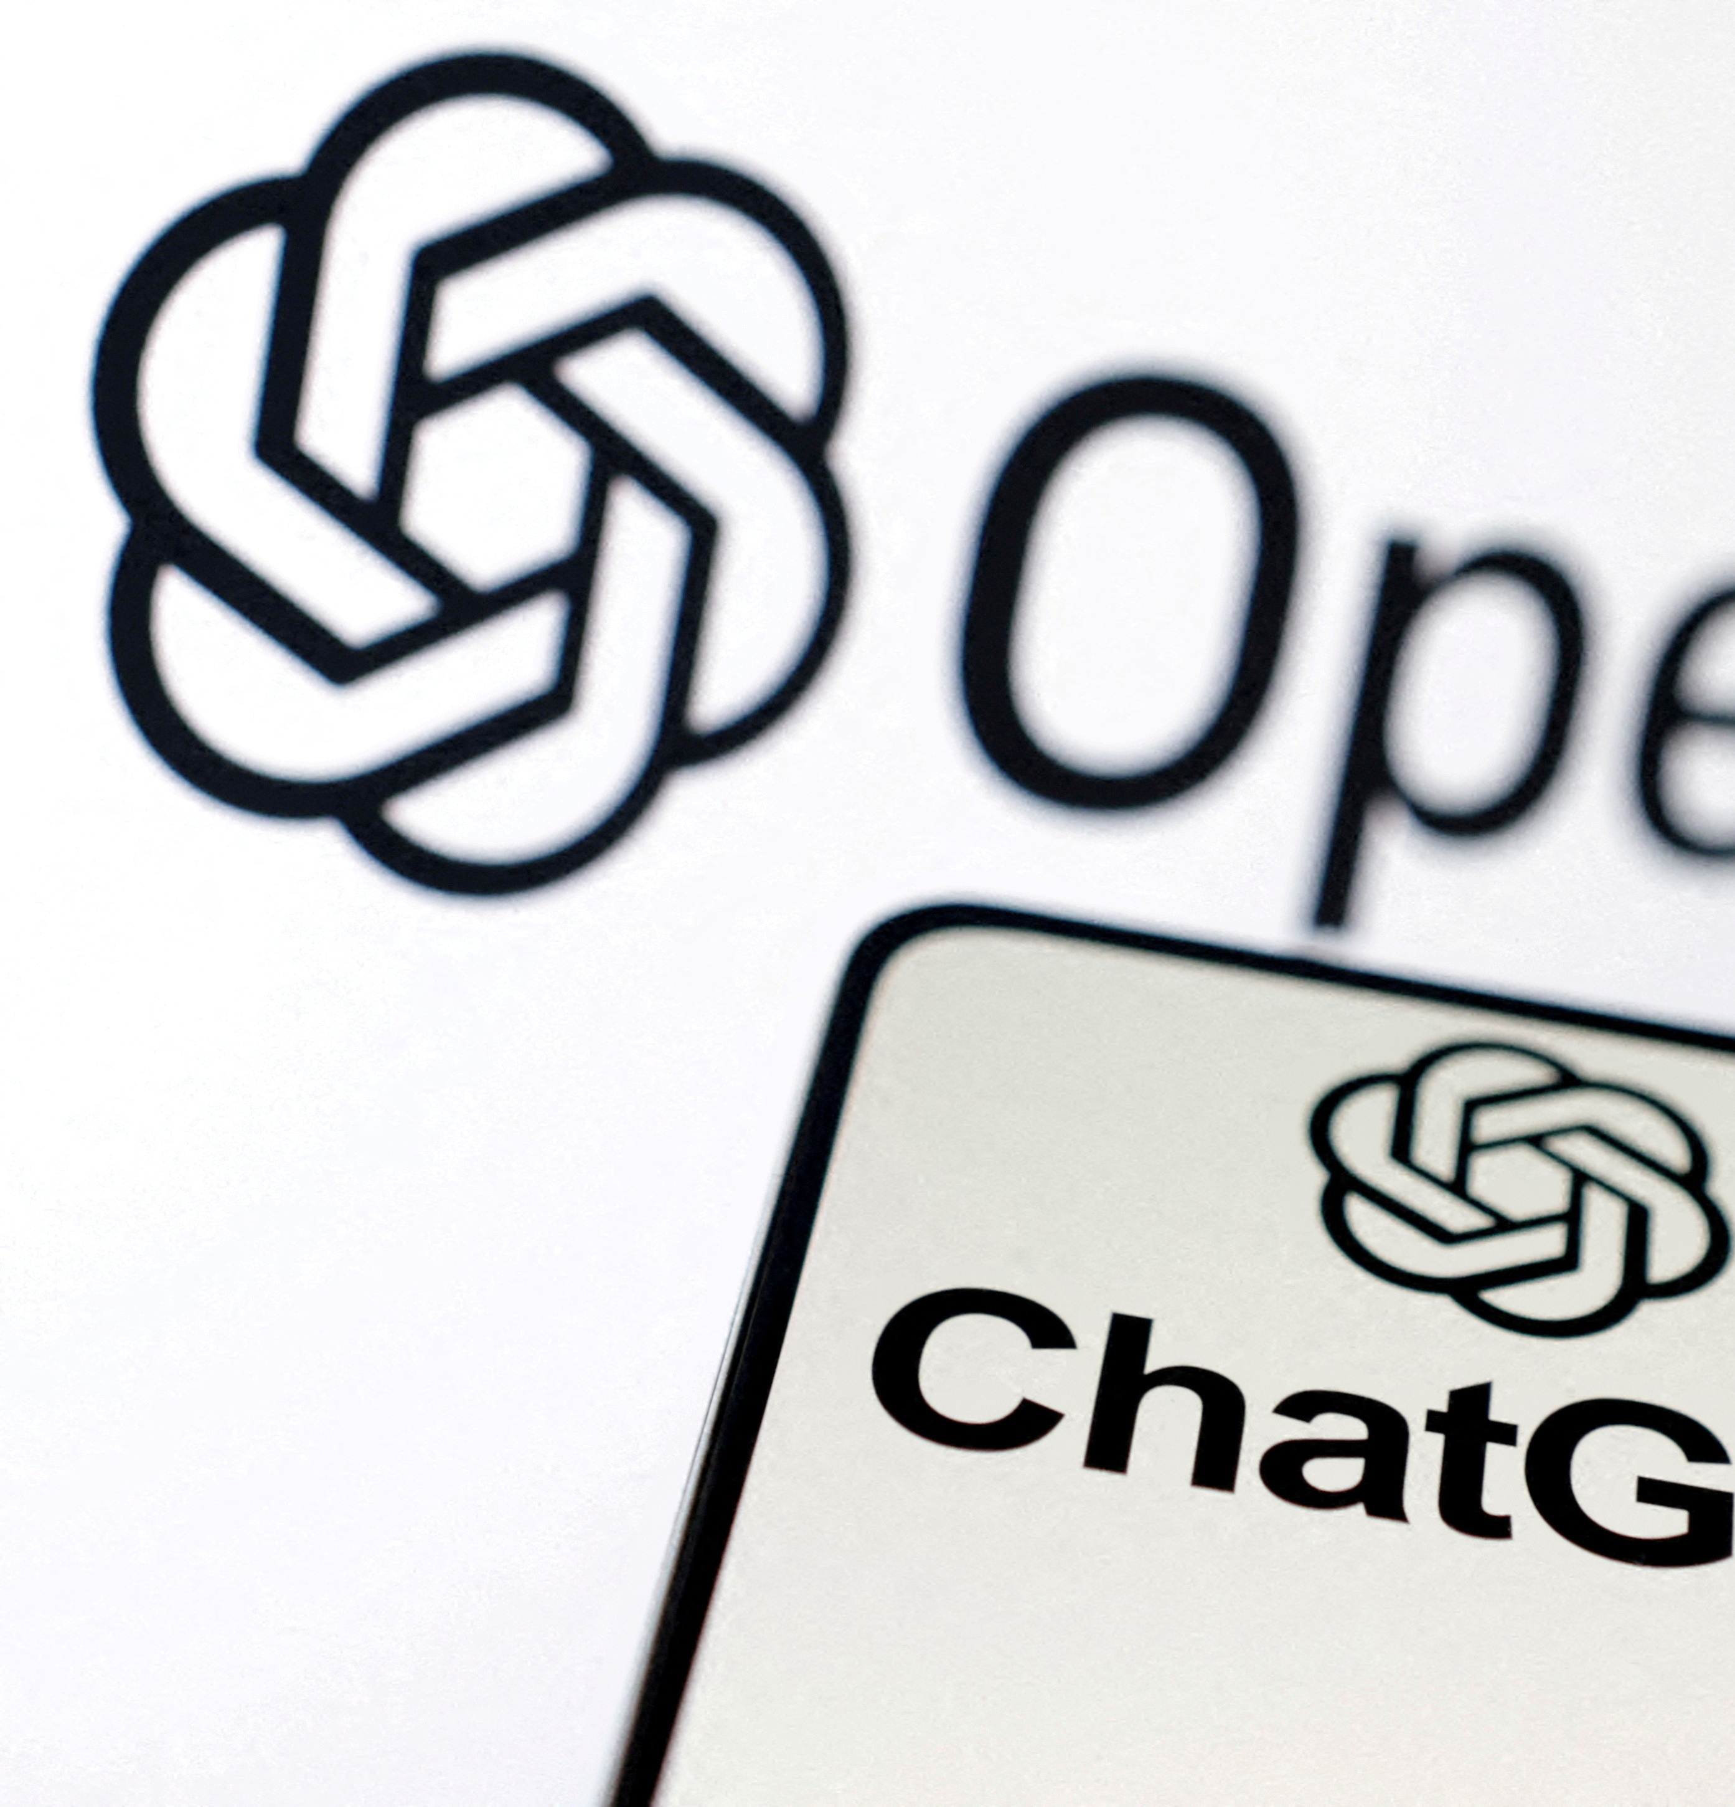
Why understand ChatGPT ?
State-of-the-Art AI: Developed by OpenAI, ChatGPT is a leading language generation model that mimics human writing.
Core Features:
Human-Like Text Generation: Capable of producing essays, poems, code, etc.
In-Context Learning: Understands and responds based on context.
Learning from Feedback: Improves with training and user interaction.
Significance of ChatGPT:
Innovation in AI: Redefines AI capabilities in language understanding and generation.
Versatility: Useful across customer service, education, content creation, etc.
The Impact: ChatGPT marks a significant advancement in AI, sparking discussions on ethical AI use and its future role in society.

Slide 3
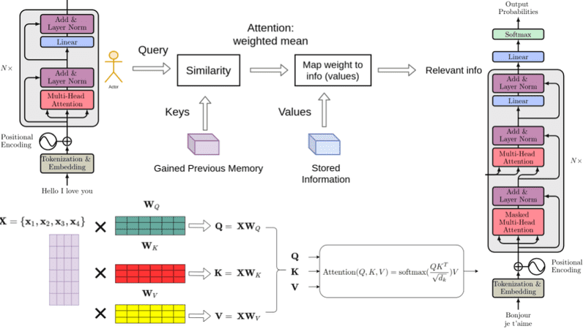
Advantages of ChatGPT's Decoder-Only Architecture
Focused Task Formulation:
ChatGPT reimagines question-answering as a next-word prediction task, using only the prompt as a textual sequence, making an encoder unnecessary.
Efficient Self-Attention:
Utilizes self-attention on the prompt plus continuation, simplifying the learning process and reducing computational load.
Advantages in Chat Applications:
Ideal for multi-turn chats, allowing sequential processing of dialogue without re-encoding previous context.
Enhances computational efficiency, critical for real-time applications.
Empirical Effectiveness:
Decoder-only models have shown to empirically work well, balancing performance with resource efficiency.
They thrive on the causal language modeling task, which is currently a focal interest in NLP.

Slide 4
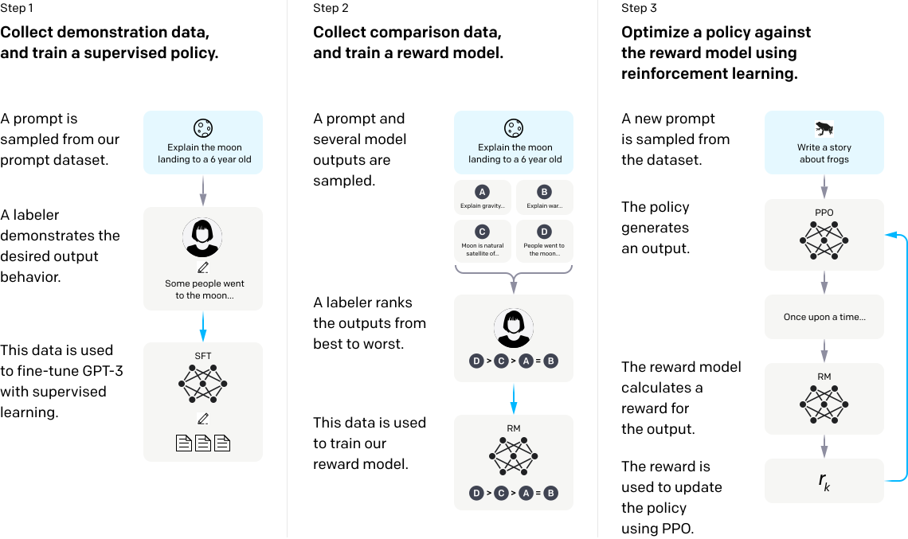
The Three-Step Training Process of ChatGPT
1. Supervised Fine-Tuning
Definition: Utilizes a dataset of human-written conversations for initial training.
Purpose: Teaches model foundational conversational skills and language nuances.
Process: Labelers respond to prompts, helping model learn desirable output behaviors.
2. Reward Modeling
Definition: A technique to evaluate and score the model-generated texts.
Purpose: Determines what characteristics make a response more human-like
Process: Labelers rank the outputs from best to worst to construct a model that understands quality.
3. Reinforcement Learning from Human Feedback (RLHF)
Definition: Fine-tuning using reinforcement learning, based on the reward model.
Purpose: Enhances the model's ability to generate high-quality responses
Process: Generates responses to new prompts, evaluates them via the reward model, and iteratively updates using Proximal Policy Optimization (PPO).

Slide 5
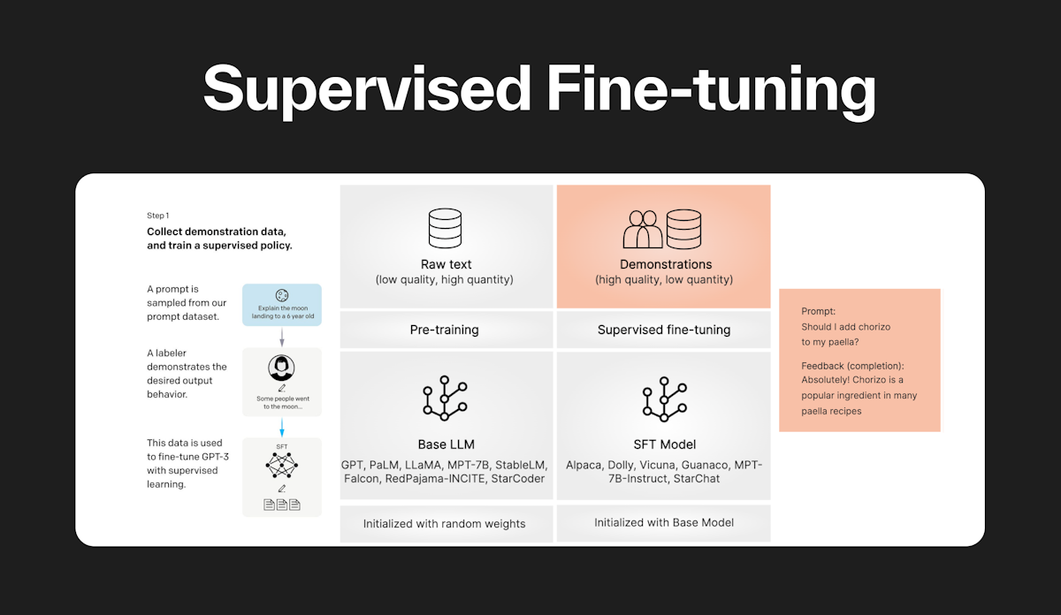
Step 1 - Supervised Fine-Tuning
Objective: Collect demonstration data to train a supervised policy for nuanced conversational understanding.
Demonstration Process:
Prompt: "Define 'serendipity' in a sentence."
Response: "Discovering Margaret and Tom was pure serendipity."
Training Method:
Human trainers enact both user and AI roles, enhancing conversations with model suggestions.
Integrates new dialogues and pre-existing data for comprehensive learning.
Task Sources:
Includes labeler-created prompts and user queries from early model versions, spanning diverse language tasks.
Labeler Guidance:
Labelers discern prompt intent, ensuring responses are clear, accurate, and considerate.
Carefully chosen for their ability to recognize nuanced and potentially sensitive content.

Slide 6
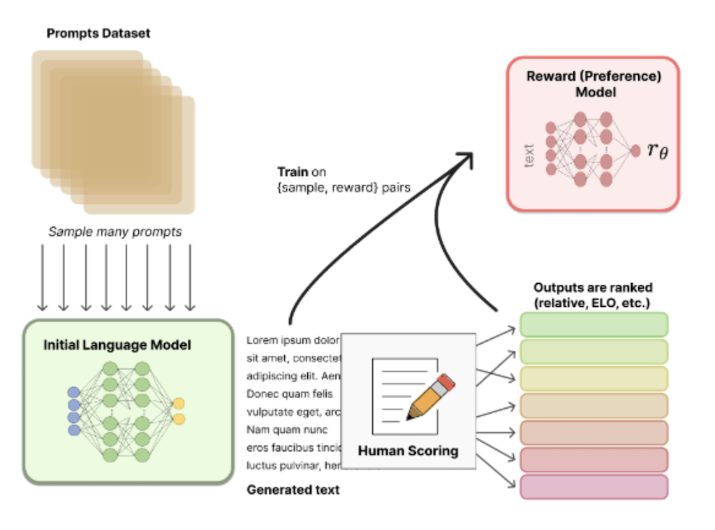
Step 2 – Reward Modelling
Objective:
Develop a model to assign scalar rewards to text based on human preferences.
Process Overview:
Generation: The fine-tuned model from Step 1 produces text samples for given prompts.
Evaluation: Human labellers rank these samples from best to worst, avoiding direct scalar scoring due to subjective variability.
Training Data: Generated pairs are grouped by prompt to prevent overfitting, enhancing computational efficiency and model accuracy.
Technical Details:
Loss Function: Utilizes a comparison-based loss function, where the model's scalar reward for the preferred text in a pair aims to be higher, minimizing loss.
Implementation: The final model, adjusted to output scalar rewards for prompt-response pairs, is fine-tuned for this specific task.

Slide 7
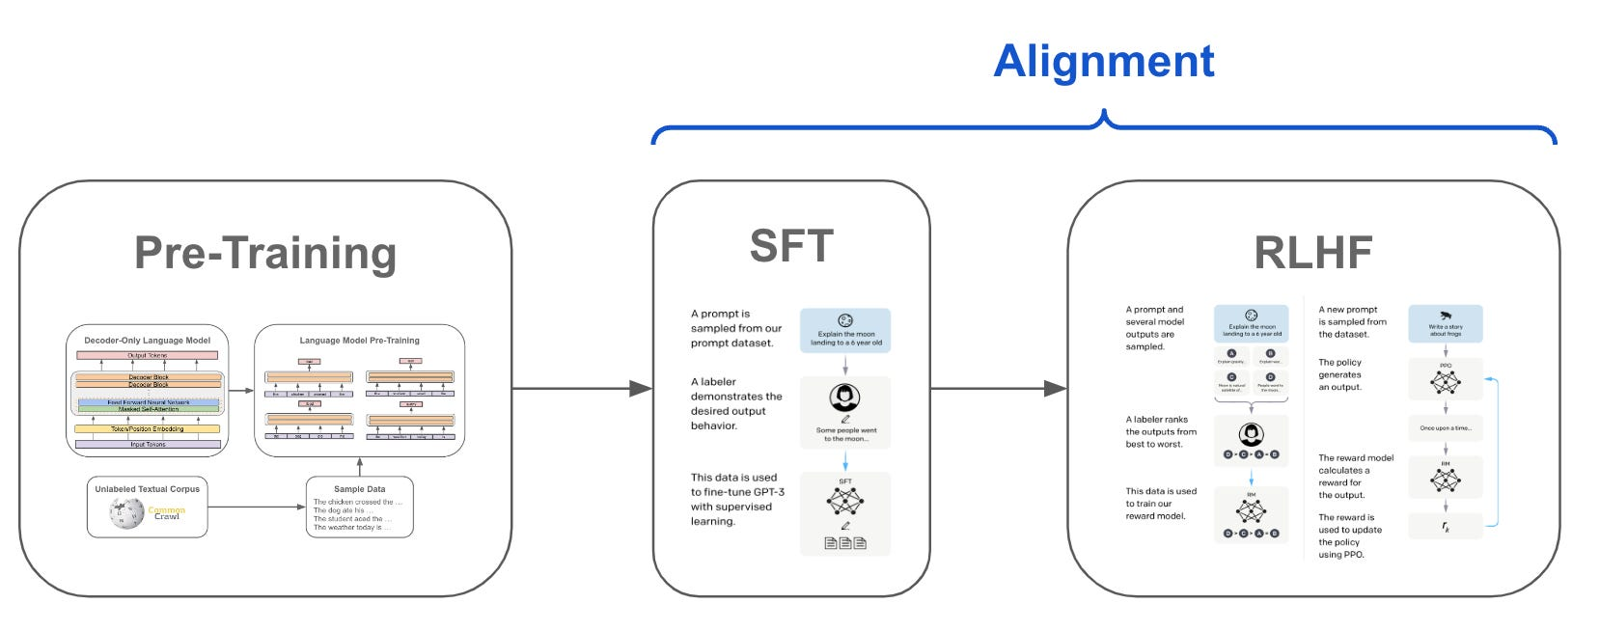
Step 3 - Reinforcement Learning from Human Feedback (RLHF)
Objective:
Refine the AI's conversational policy to align with human preferences using the Proximal Policy Optimization (PPO) algorithm.
Process:
Integration of Reward Model: Utilizes the reward function π from Step 2 to define the RL objective.
Objective Function: Balances the learned RL policy π with the supervised fine-tuned model π0, incorporating the KL reward coefficient α.
Regularization and Exploration:
The KL penalty encourages the policy to remain close to the original supervised model, ensuring stability.
The environment, represented by the PPO dataset, encourages exploration and learning without direct human labels.
Optimization:
Uses Gradient Ascent to iteratively update the model, enhancing its response quality based on the reward model's feedback.
Iterative Improvement:
Continuous refinement through repeated cycles of comparison data collection, reward model training, and policy optimization.

Slide 8
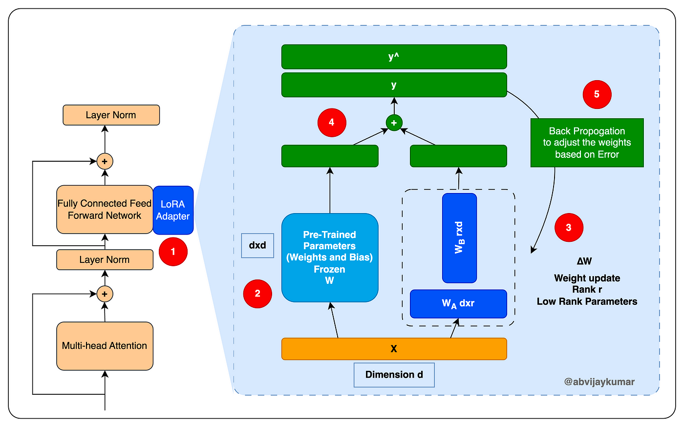
Technical Enhancements in User-Data Fine-Tuning for ChatGPT
Incorporating Advanced Fine-Tuning Techniques
Techniques Overview: Utilize Parameter-Efficient Fine-Tuning (PEFT) methods like Low-Rank Adaptation (LoRA) to update ChatGPT based on user feedback while maintaining computational efficiency.
Focus: Adapt the model to user preferences and feedback while avoiding extensive retraining.
Integrating User Feedback
Process: Collect and preprocess user feedback. Apply PEFT techniques to make targeted updates to the model's parameters, improving relevance and personalization.
Example: Implementing LoRA to adjust specific parts of the model influenced by user interactions.
Addressing Technical Challenges
Key Challenges: Scalability of updates, bias mitigation, and ensuring parameter updates don't compromise general performance.
Solutions: Advanced analytics for bias detection, differential privacy for data protection, and focused parameter updates to maintain model integrity.

Slide 9

Conclusion
References :
https://openai.com/research/instruction-following
https://subedi.medium.com/chatgpt-101-pre-training-56a98f04389
https://www.analyticsvidhya.com/blog/2023/05/how-does-chatgpt-work-from-pretraining-to-rlhf/
https://s3-us-west-2.amazonaws.com/openai-assets/research-covers/language-unsupervised/language_understanding_paper.pdf
https://medium.com/@amol-wagh/open-ai-understand-foundational-concepts-of-chatgpt-and-cool-stuff-you-can-explore-a7a77baf0ee3

